Slide 1

Section 3.1 Derivatives of Polynomials and Exponential Functions
Lecture 1
Tackling basic functions

Slide 2

Homework Submission to Canvas
Preview of section
Skim the section in text and write a short paragraph summary.
Give a bulleted list of all important definitions, theorems, and formulas without details.
Notes on video lectures
Take notes on everything written on slides including all details, worked examples, on-own activities, as well as your own thoughts and questions.
Try on-own activities first, then write down provided solution next to it for comparison.
Worked examples from the text
Write down the problem and attempt without looking at the solution.
Use the solution to write the best explanation you can.
Solutions to textbook exercises
Model approaches and explanations given in the video lectures and textbook examples.
Final reflection of section
List the key takeaways to remember as a bulleted list.
Video reflection (for some sections)
Write a 1 paragraph reflection on the video discussing what you found most interesting or useful.

Slide 3
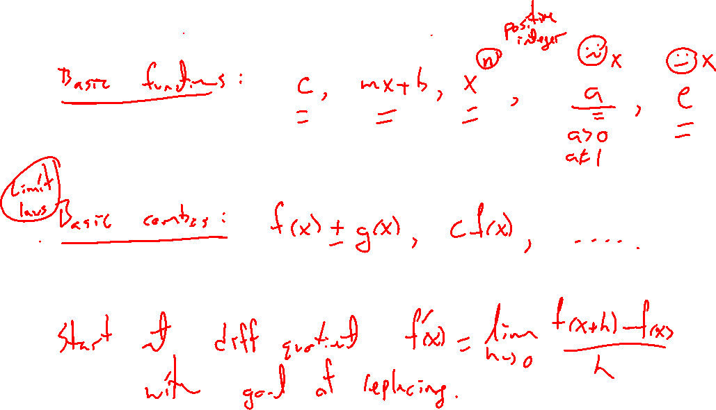
Begin with basic functions
Notes:
C, mx+b, x^2, x^n, e^x, a^x
Apply difference quotient to each. H version easiest.

Slide 4
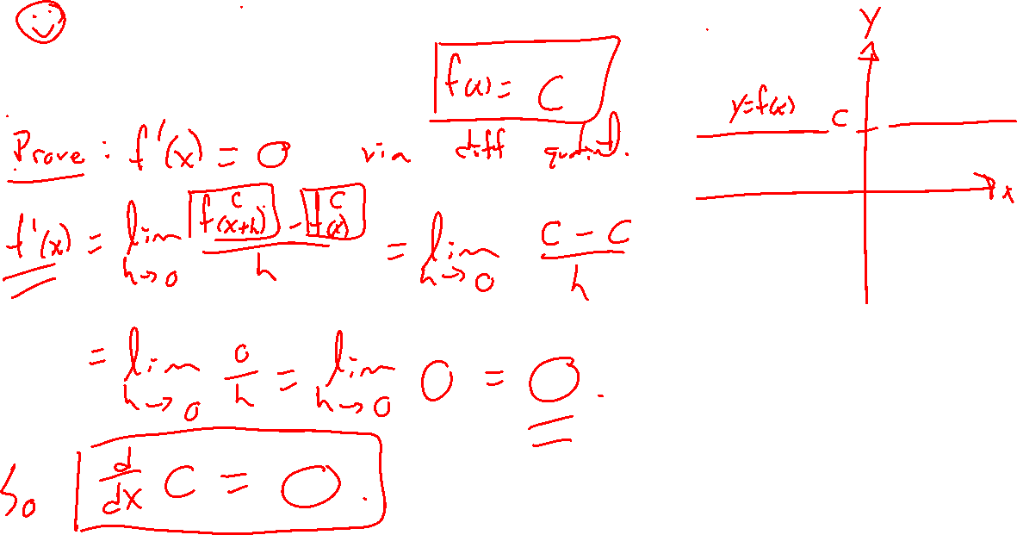
Example: Try on own
Notes:
Use diff quotient to prove d/dx (mx+b) = m

Slide 5
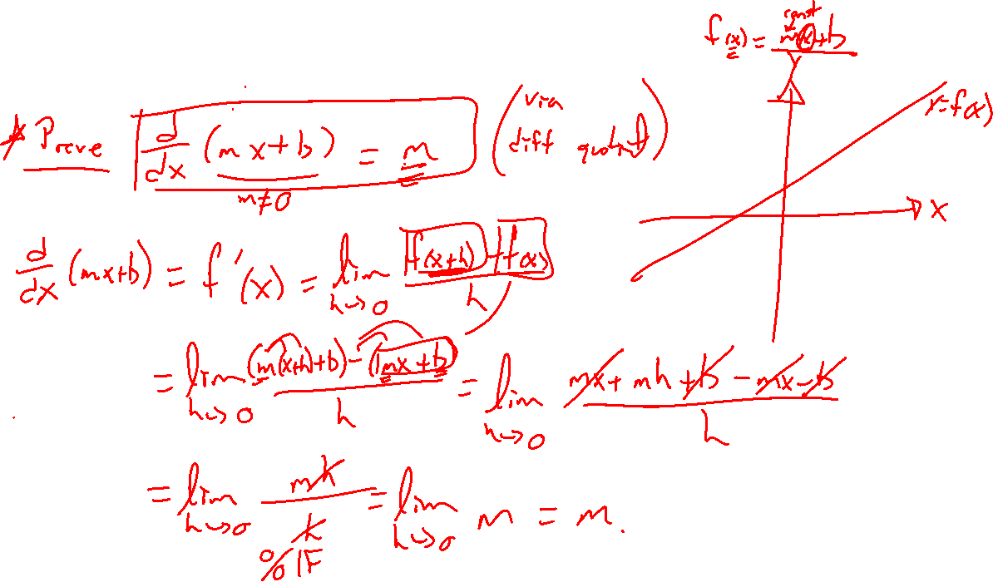
Example: Try on own
Notes:
Use diff quotient to prove d/dx c = 0

Slide 6
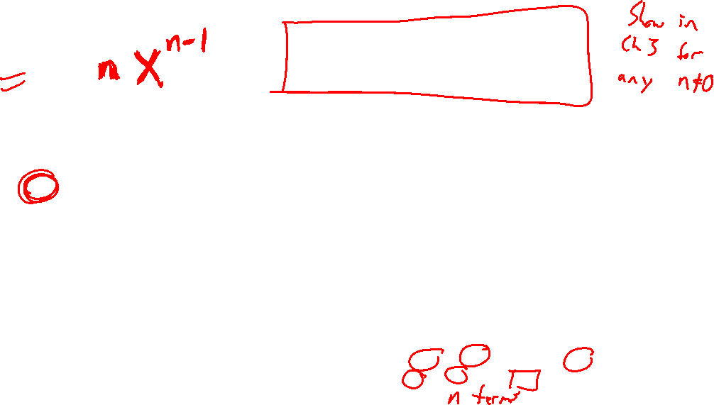
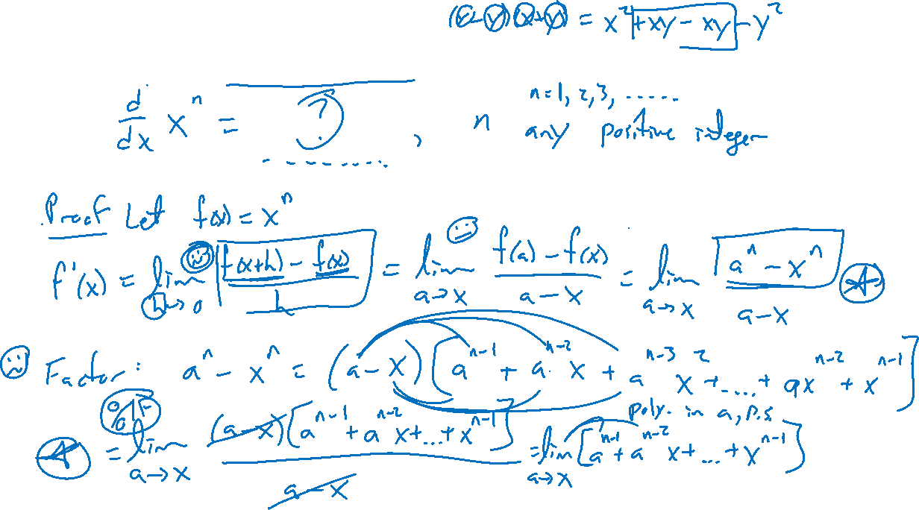
Theorem: Power rule
Notes:
D/dx x^n = …
Proof: H form has trouble with expanding. Try other form and use factoring.
Note only applies to non negative integers, will extend later to any power.
Super easy to use: Apply to random power with root.

Slide 7
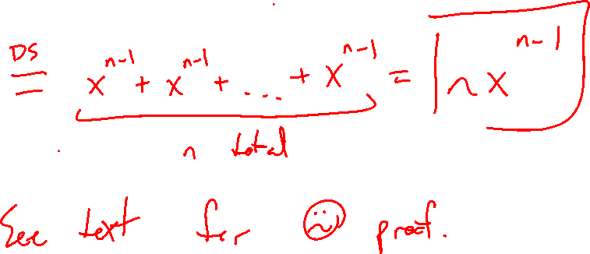

Slide 8
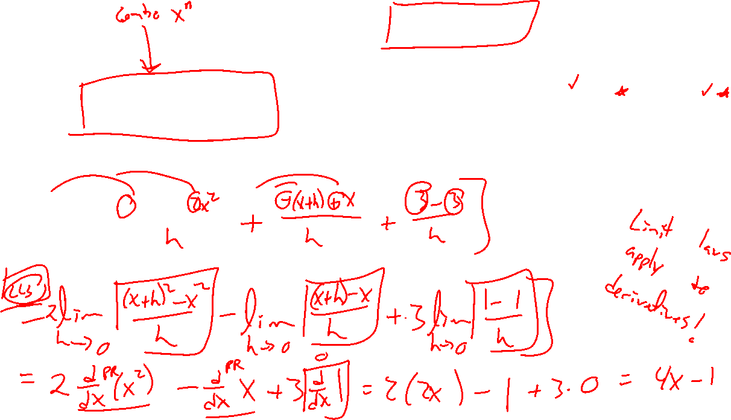
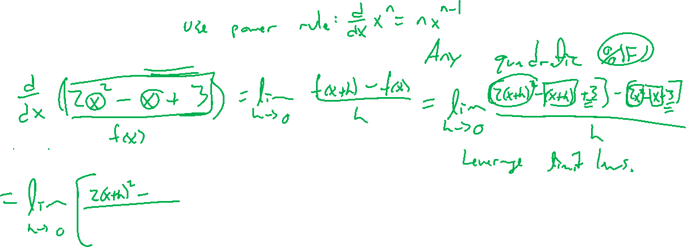
Example: Hint at a better way
Notes:
General quadratic, reformulate as 3 separate power rules.

